Slide 1
PHYSICAL PROPERTIES OF POLYMERS
THERMAL BEHAVIOR
MECHANICAL PROPERTIES
ELECTRICAL PROPERTIES

Slide 2
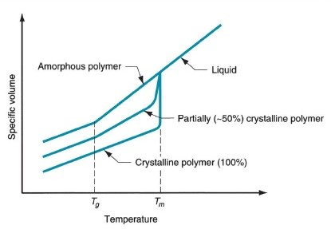
Thermal Behavior of Polymers
Glass Transition Temperature (T_{g})
Glassy State
Hard & Brittle
No segmental motion
Molecular mobility
Glass Transition Temperature
(T_{g})
Rubbery State
Soft & Flexible
Segmental motion
No Molecular mobility

Slide 3
T_{g} and T_{m}
Polymer | Tg (˚C) | Tm (˚C)
Polyethylene (PE) | -125 | 146
Polyvinyl chloride (PVC) | 81 | 310
Polyvinyl acetate (PVAc) | 32 | -
Polystyrene | 100 | 250
Polyethyelene terephthalate (PET) | 69 | 264

Slide 4
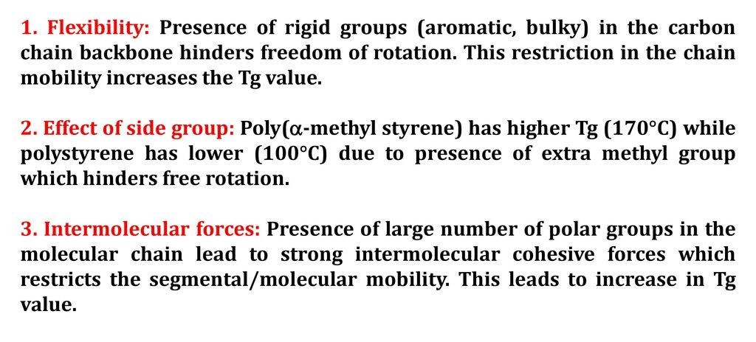
Factors affecting T_{g}

Slide 5
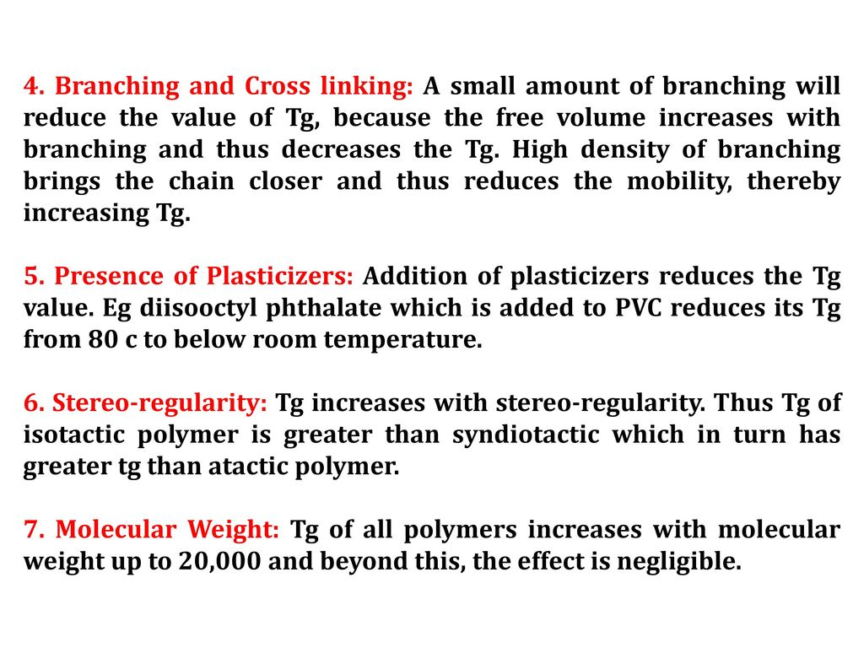

Slide 6
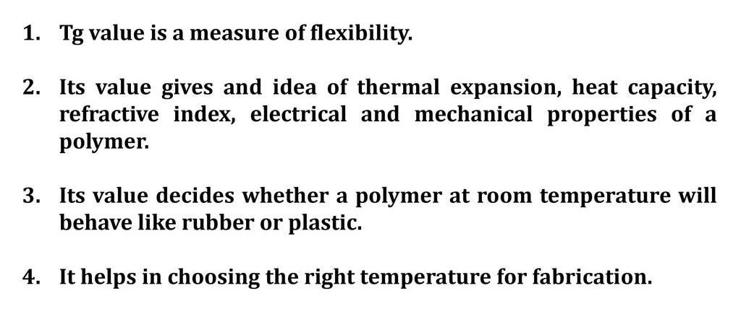
Significance of T_{g}

Slide 7
Thermal analysis of polymer
Measurement of physical property of polymer as a function of temperature.
Different methods:
Differential Scanning Calorimeter (DSC)
Differential Thermal Analysis (DTA)
Thermogravimetric Analysis (TGA)
DSC records the energy necessary to establish a zero temperature difference between
the sample and reference material as a function of time or temperature.
In DSC, both sample and reference are subjected to identical temperature conditions in an environment which either heated or cooled at a controlled rate.
In contrast, DTA involves measuring the difference in temperature between the sample and reference material as a function of time or temperature.

Slide 8
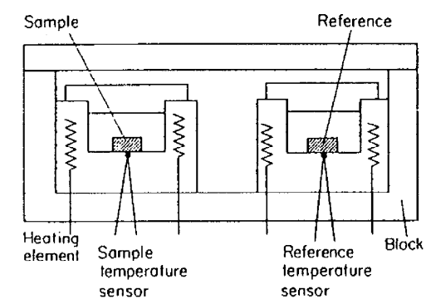
Schematic Representation of DSC Instrument

Slide 9
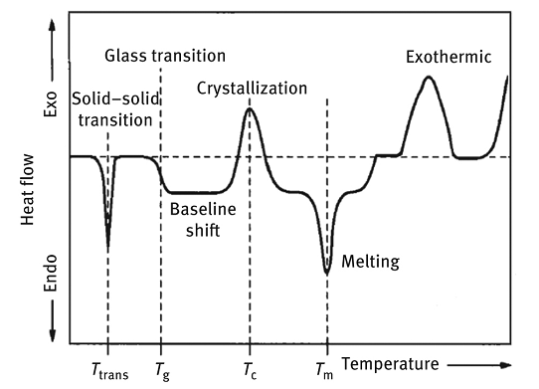
DSC Thermogram of a polymer

Slide 10
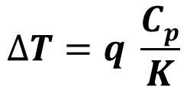

A shift in baseline results from change in heat capacity of the sample. The basic equation used in DSC analysis is,
ΔT = Difference in temperature between reference material and sample.
q = Heating rate
C_{p} = Heat Capacity @ constant pressure
K = Calibration factor for particular instrument
DSC used for measuring the enthalpy involved in polymer transitions.
The peak area between the curve and baseline is proportional to enthalpy change (ΔH) in the sample.
This enthalpy change can be determined from the area of the curve peak (A) by using the equation,
Where, m is the mass of polymer sample.

Slide 11
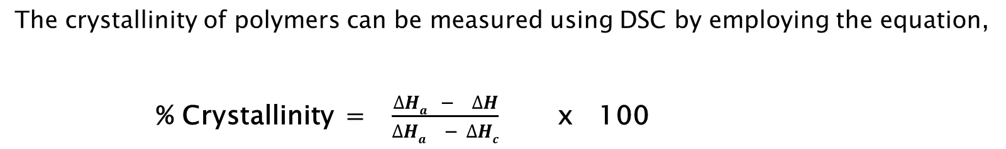
ΔH = enthalpy change of unknown sample
ΔH_{a} = enthalpy change of pure amorphous standard
ΔH_{c} = enthalpy change of pure crystalline standard
When, ΔH_{a} = 0, % crystallinity = 100 ΔH/ ΔH_{c}

Slide 12
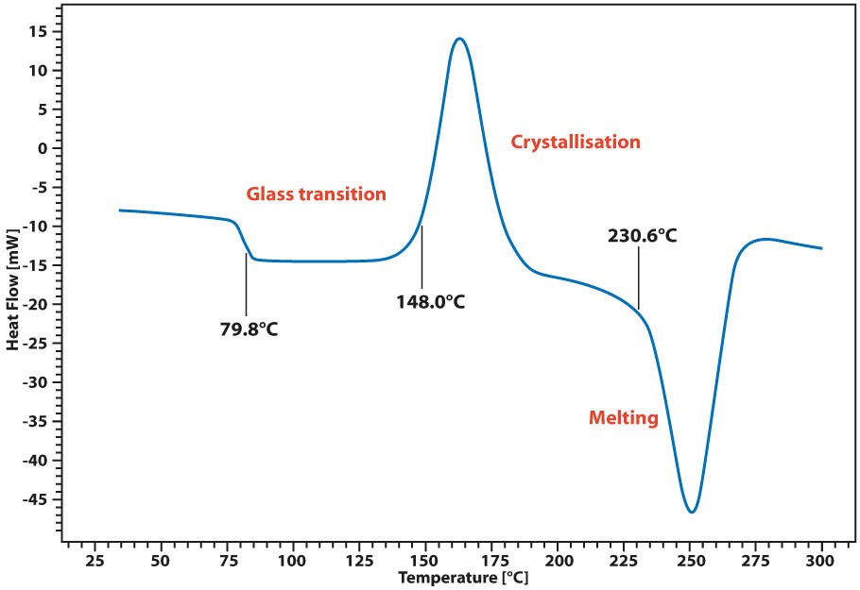
DSC curve of a PET

Slide 13
Mechanical Properties of Polymers
The mechanical behavior of polymer can be classified according to different molecular mechanisms.
Viscous flow:
The irreversible bulk deformation of a polymer, associated with the irreversible slippage of molecular chains past one another.
2. Rubber-like elasticity:
Involves small-scale movement of chain segments.
3. Visco-elasticity:
Polymer flow in response to an applied stress and the extent of this flow is time-dependent. This behoviour is a combination of elastic & viscous response.
There are a number of fundamental techniques used to characterize the mechanical properties of polymers. They are:
tensile, flexural, tear strength, fatigue, impact & hardness test.

Slide 14
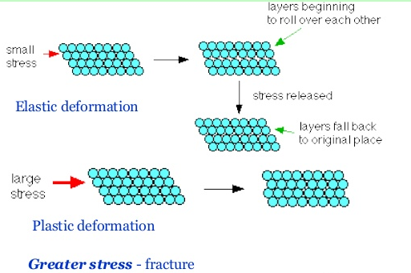
Deformation of Polymers
Elastic Deformation:
The deformed polymer returns to its original shape and size when the forces causing the deformation are removed.
Reversible deformation.
Plastic Deformation:
The deformed polymer does not returns to its original shape and size when the forces causing the deformation are larger than that for elastic deformation.
Irreversible deformation.

Slide 15
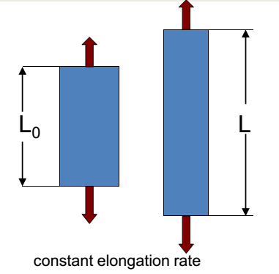
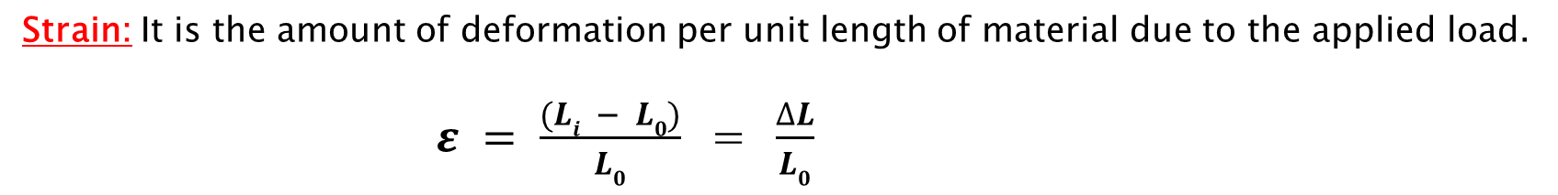
Stress – Strain Behaviour of a polymer
The degree to which a material will strain depends on the magnitude of the imposed stress.
Stress: It is defined as the load (F) per unit area (A), i.e.
 = F / A
Three basic types of stress measurements:
Tensile stress – Resistance of material to ‘stretching’ forces.
Compressive stress – Resistance of a material to ‘squashing’ forces.
Shear stress – Resistance of a material to ‘push-pull’ forces.
i
Where, L₀ = original length of sample before any load is applied
L_{i} = instantaneous length
ΔL = amount of elongation

Slide 16
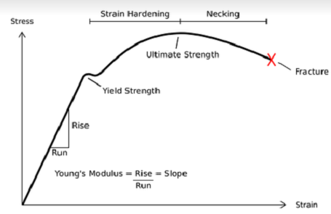
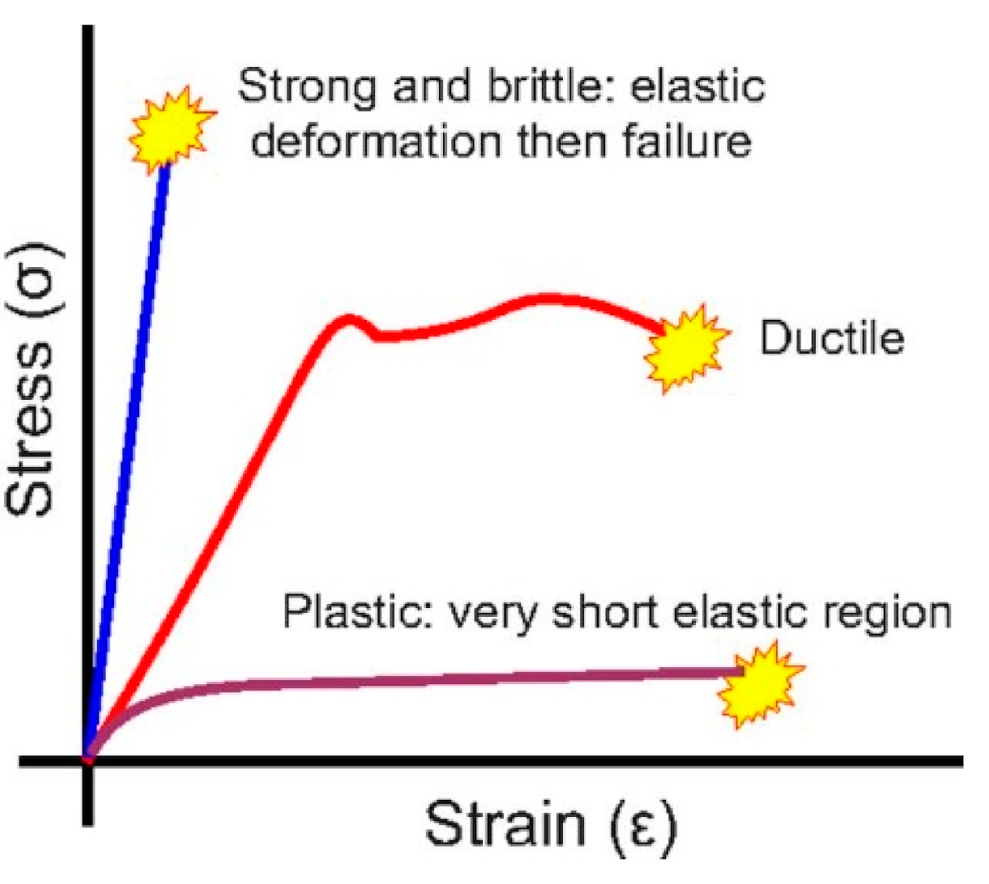
Stress – Strain Behavior of a polymer

Slide 17
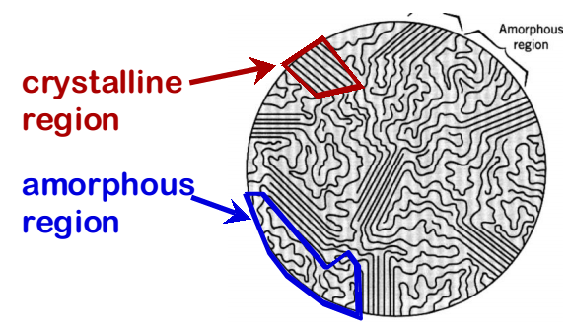
Stress – Strain Behavior of a polymer
A Polymer has both amorphous & crystalline regions.
Since polymers are rigid and has flow nature, they can be considered as Viscoelastic materials
An ideal linear elastic solid obeys Hooke’s law, i.e. stress is proportional to strain.
Whereas, an ideal viscous liquid obeys Newton’s law, i.e. stress is proportional to the rate of change of strain.

Slide 18
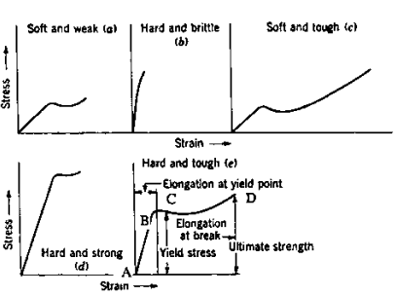
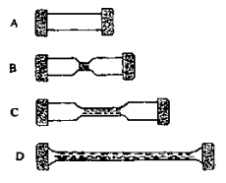
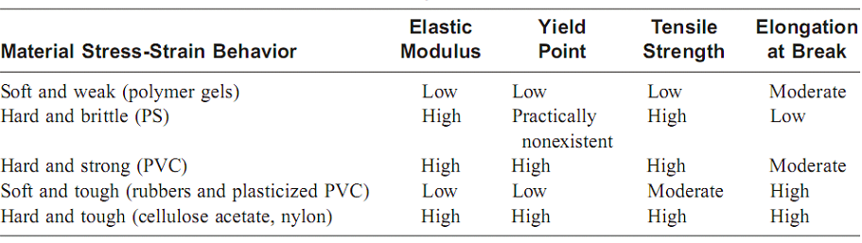
Stress – Strain Behavior of a polymer

Slide 19
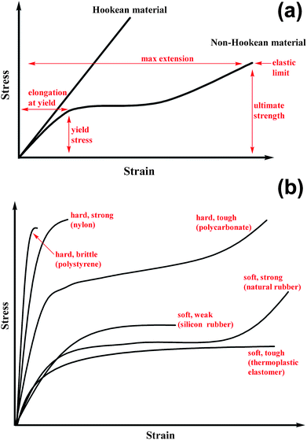
Stress – Strain Behavior of a polymer
Elastic and Plastic behavior
Classification of polymers based on stress-strain behavior

Slide 20
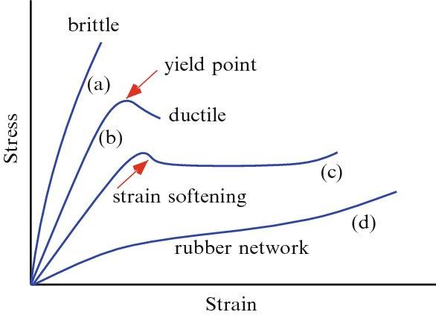
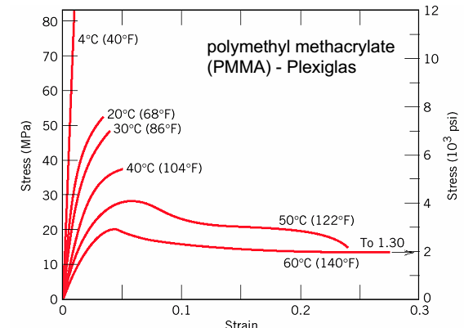
Stress – Strain Behavior of a polymer
Effect of Temperature
Typical stress-strain curves of polymers tested at different temperatures:
Stress-strain curves of PMMA tested at different temperatures:
Curves (a)-(c) represent glassy polymers (i.e., temperature interval T < T g ) with increasing temperature from (a) to (c). The curve (d) corresponds to the rubber state, i.e., to T > T g. Ends of the curves indicate the points of material failure: (a) brittle and (b)-(d) ductile
Tg of PMMA ranges from 85 to 165 °C – all of the above curves are for temperatures below Tg.

Slide 21
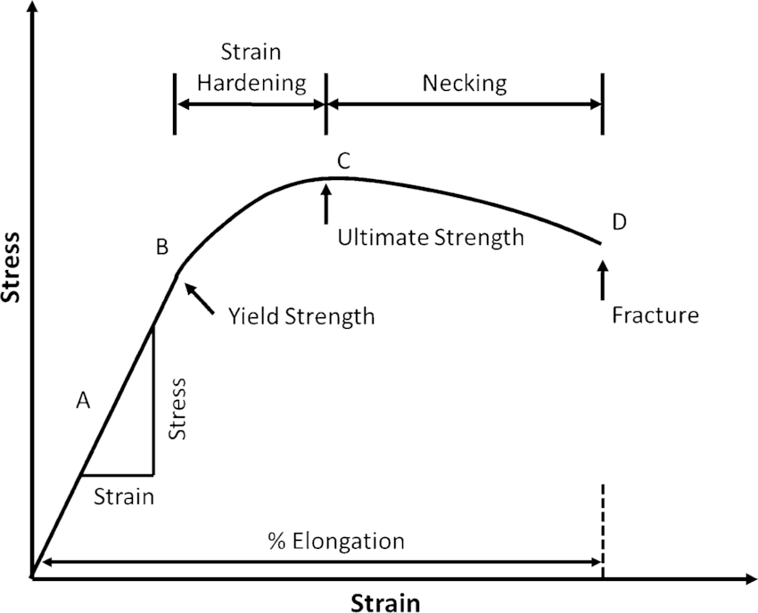
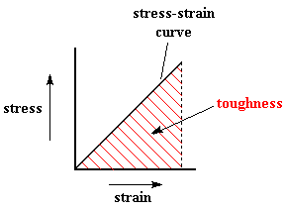
Stress – Strain Behavior of a polymer
Young’s Modulus:
The slope of stress-strain graph in the initial linear region gives Young’s modulus or tensile modulus or modulus of elasticity. It is the ratio of stress to strain.
E =  / 
Yield Point:
The bending or yielding region at where the polymer transforms from being elastic to plastic is called yield point. It is defined in terms of yield stress and yield strain.
Toughness:
The energy or work required to break the polymer sample is called toughness. The area under the stress-strain graph is a measure of toughness of material.
Tensile strength:
The stress at which the fracture of the material occurs is called tensile strength, i.e. the maximum stress that can be sustained by a material under tension.

Slide 22
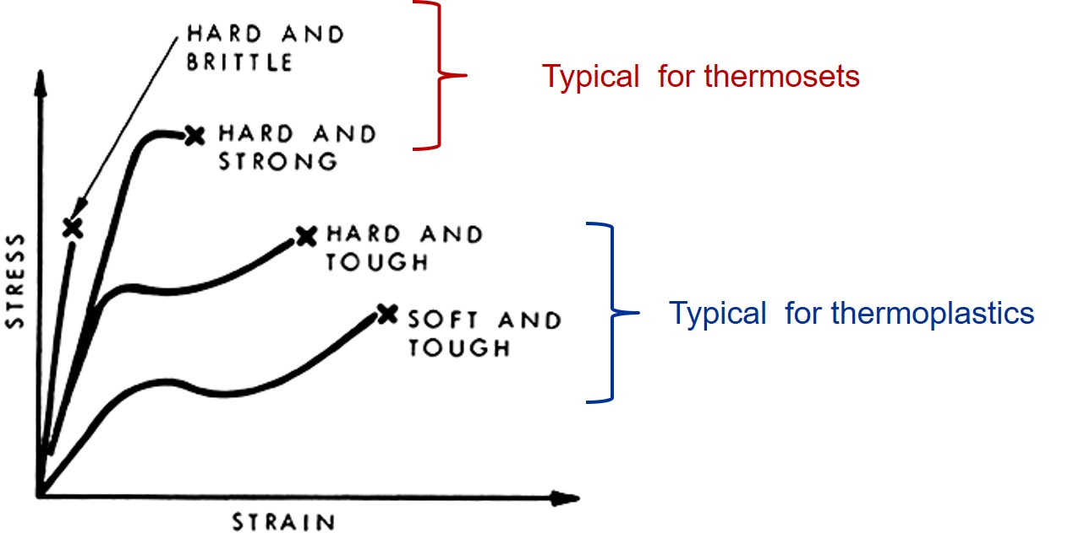
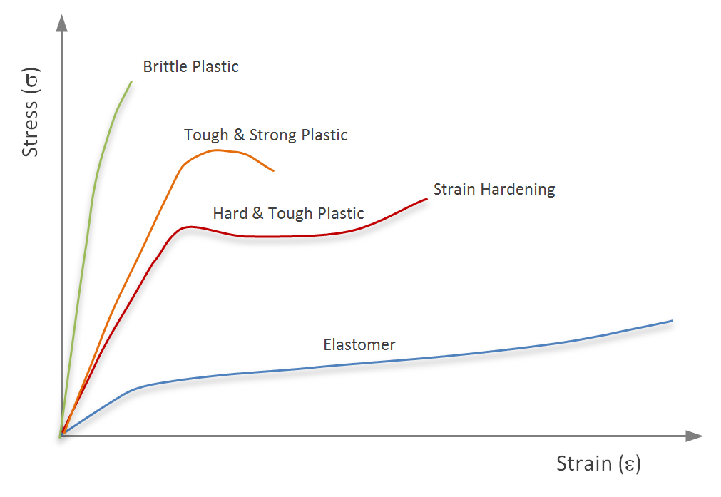
Stress – Strain Behavior of a polymer

Slide 23
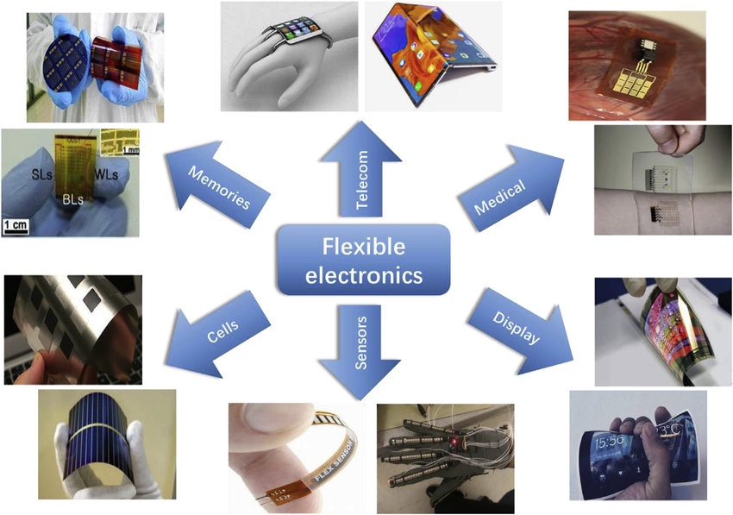
Flexible electronics

Slide 24
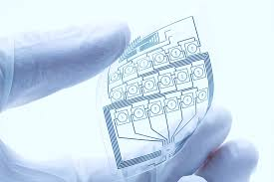
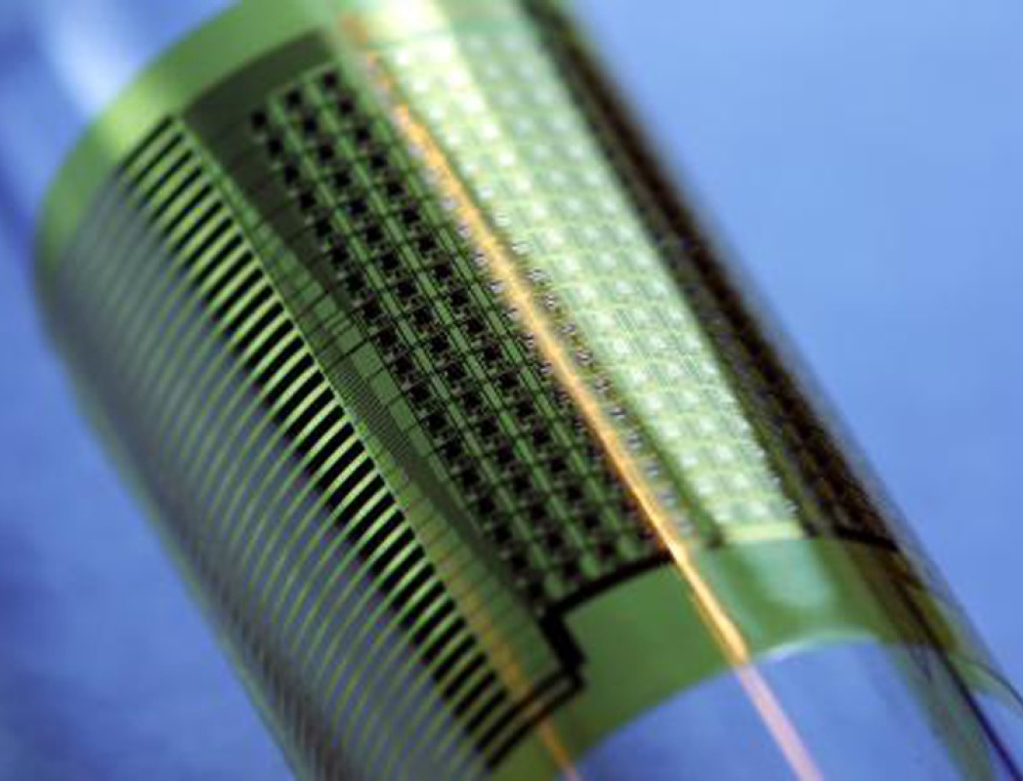
Polymers in Flexible electronics
Thin layer of polymer substrate with
printed circuits
Materials in flexible electronics are graphene, carbon nanotubes (CNTs), liquid metals and conducting polymers.
Flexible electronics may involve electronic devices mounted on plastic substrates like polyimide (PI), polyether ether ketone (PEEK), polydimethyl siloxane (PDMS) and a transparent polyester film which is made conductive.
The active electronic components are organic electronic materials attached to plastic substrates.
The extent to which and the number of times, these multilayer structures can be safely bent or stretched or twisted are essential.
The mechanical stress – strain analyses of the polymer can provide effective information related to the main damage events and the state of strain in a complaint substrate coated on both sides of a film.

Slide 25
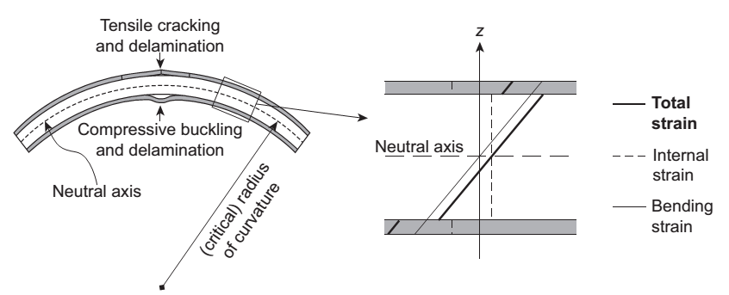
Stress – Strain analyses in Flexible electronics
Bending to some radius of curvature, the film located on the convex (top) side experiences tensile strain and may crack and eventually delaminate. The film located on the concave (bottom) side experiences compressive strain and may also delaminate and buckle and possibly crack as well.
The neutral axis is the plane where the strain does not change upon pure bending.
The total strain is the sum of an internal strain and a bending strain. The internal strain is essentially controlled by the fabrication process, and is assumed to be compressive in the two films and tensile in the substrate.
The bending strain results from the curvature applied during service & proportional to the distance from the neutral axis
Sketch of damage events and strain state in a flexed substrate coated on both sides with thin films.

Slide 26
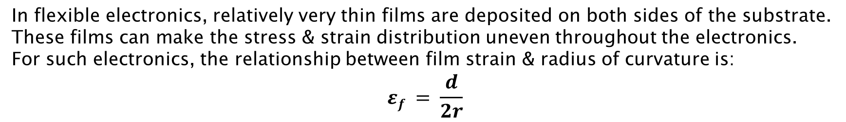
Stress – Strain analyses in Flexible electronics
Where, d = thickness of substrate
r = radius of curvature
_{f} = film strain
Critical radius of curvature
The critical radius of curvature, R_{crit}, is among the key design parameters for flexible electronics. It is defined as the radius of curvature at which device failure occurs because of mechanical damage or functional failure (e.g., electrical failure). Failure in fact occurs at a critical strain, _{crit}.

Slide 27
Stress – Strain analyses in Flexible electronics
Depending on the critical strain level, one may discriminate various terminologies:
• flexible electronics, which comprise films with _{crit} < 2%, are based on substrate materials that are thin enough (100 mm) to be safely bent to radius of curvature down to 10 mm, but cannot be stretched.
• compliant electronics, for which 2% < _{crit} < 10%, can be flexed to radius of curvature of few mm, allow some in-plane loading, and can be used with thicker substrates.
• stretchable electronics, for which _{crit} > 10%, can be conformed to a broad diversity of surfaces with two-dimensional curvatures and small radius below a few millimeters.

Slide 28
Residual Stresses in multilayer structures
Prediction and control of residual stresses is crucial to achieve high-dimensional stability and avoid premature damage in multilayer structures.
For both vapor-formed and solution-processed films, residual stresses include intrinsic, thermal, and hygroscopic contributions.
Intrinsic stresses are associated with process-induced disorder (tensile or compressive in inorganic films) and a number of shrinkage mechanisms (generally tensile in organic films).
Thermal stresses develop upon cool-down from process temperature or upon temperature variations during service, because material constituents have mismatched thermal expansion coefficients. Thermal stresses are generally compressive in inorganic films and maybe tensile or compressive in organic films when using polymers as substrates.
Hygroscopic stresses also develop upon exposure to ambient humidity because of a mismatch in hygroscopic expansion between material constituents. Hygroscopic stresses are generally tensile in inorganic films and can be tensile or compressive in organic films.

Slide 29
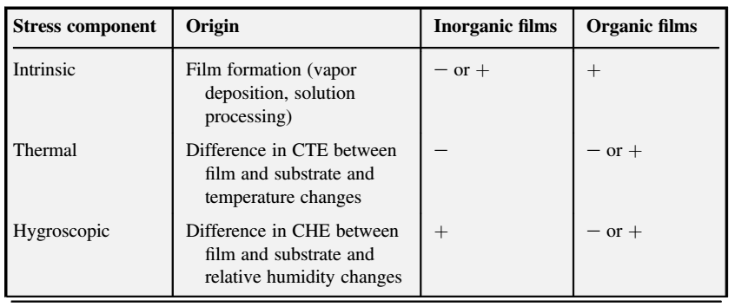
Summary of intrinsic, thermal, and hygroscopic contributions to residual stresses in inorganic and organic films
- is compressive stress
+ is tensile stress

Slide 30
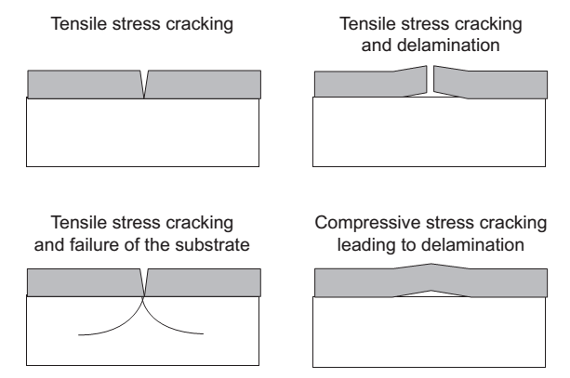
Failure mechanisms in multilayer films
Channeling cracks initiate in brittle films on substrates under tensile load and further loading may lead to delamination at the film/substrate interface or failure of the substrate.
Compressive loading may lead to buckling failure, also leading to delamination.

Slide 31
Electrical properties of polymers
Polymers as electrical insulators
An electrical insulator is used in an electrical system to prevent unwanted flow of current to the earth from its supporting points. An electrical insulator is a very high resistive path through which practically no current can flow.
Typical requirements for an electrical insulator are: it must have a high enough dielectric strength to withstand an electrical field between the conductors; it must have a high insulation resistance to prevent leakage of current across the conductors. Polymers having high dielectric constant can be used for applications such as film capacitors, artificial muscle, while the ones with low dielectric constants are used in the field of capacitors and dielectric materials.

Slide 32
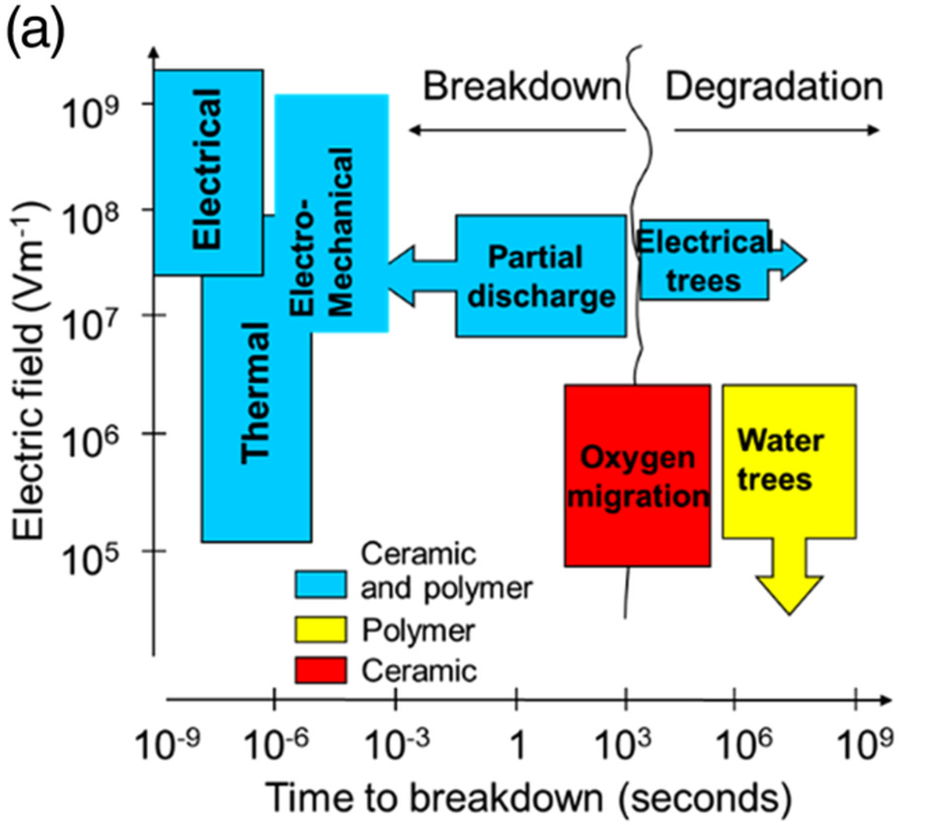
Dielectric Breakdown
When a piece of dielectric material is placed between electrodes and subjected to a steadily increasing voltage, at one point the insulating barrier will be exceeded and a sudden, catastrophic total breakdown will occur.
With very high voltage, a great amount of electrical energy is released and the material will burn out in the breakdown area. The breakdown occurs at a location with some imperfection or non-uniformity.
An intrinsic resistance of the material to high voltage referred to as dielectric breakdown strength (E_{B}), can be as high as 100 MVm⁻¹ for a homogeneous solid.
The principal mechanisms of dielectric breakdown in polymers can be listed as:
(1) electronic
(2) thermal
(3) electromechanical
(4) gas discharge

Slide 33
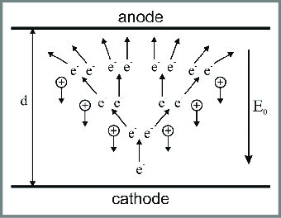
Electronic Breakdown Electronic breakdown is initiated by the small number of electrons that are available for acceleration by the applied field. By the analogy with the mechanism of sparking gases, one can imagine that a Townsend-like avalanche may occur whenever the field is high enough for a conduction electron to gain sufficient energy to excite more electrons by collisions.
Thermal Breakdown Whenever there is sufficient conductivity present in a dielectric to produce appreciable joule (ohmic or resistive) heating in an applied field, the possibility of thermal runaway exists. In alternating fields, there may be additional heat generated by relaxation processes and that will hasten the onset of any thermal runaway condition

Slide 34
Electromechanical Breakdown The mechanism is based on the fact that the breakdown characteristics of polymers in the temperature region near the melting (softening) point are similar to their changes of mechanical characteristics. The breakdown is caused by the mechanical deformation resulting from stress under the applied electric field.
Gas-Discharge Breakdown The dielectric strength of a gas is much less than that of a solid insulator, which is on the order of 3 MV m⁻¹. Consequently, during the application of a high voltage to a solid specimen, discharges are likely to occur at an early stage in any gas that is at the edges of the electrodes or may be occluded as bubbles in the solid. Such external or internal discharges tend to damage the solid, and repeated discharges lead to dielectric failure.

Slide 35
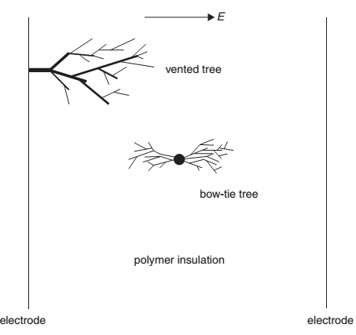
Treeing in Polymers
Electrical breakdown starts frequently with prebreakdown that is called treeing. Treeing has been recognized as a cause of long-term electrical failures in solid dielectrics. In general, two kinds of trees exist in polymers:
(1) electrical - generated by an electrical field alone (2) water trees - generated by an electrical field together with water or various chemicals.

Slide 36
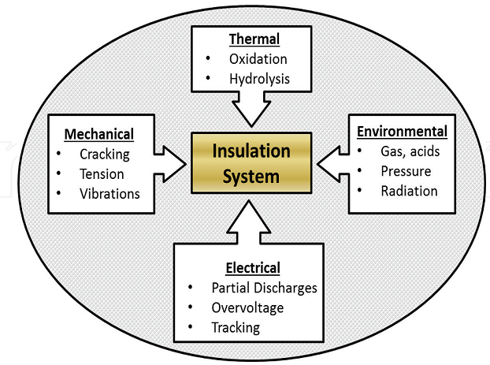
Ageing in polymer insulation systems
The ageing process present in the insulation systems of an electric machine or equipment can be defined as the irreversible changes of their intrinsic properties due to action by one or several degradation mechanisms or factors.

